Slide 1
Failure of the coding theorem for randomized stopping machines
Mikhail Mironov
Mentors: Aram Ebtekar, Cole Wyeth

Slide 2
Plan
Solomonoff induction, AIXI agent, coding theorem
Stopping complexity, Golden handcuffs AIXI, stopping coding theorem
Proof of the coding theorem

Slide 3
Solomonoff induction: we want to predict next observation
(we only observe, we do not take actions)
Real world | Solomonoff
Sequence of observations | Sequence of bits 010010101…
Predict next observation | Predict next bit
List of possible environments (world models) | List of all possible programs (in Python) (option: could use randomness)
Starting distribution over environments: Occam razor favors simpler explanations – more complex environments are less probable | Starting distribution over programs: Weight of program is proportional to where is the length of the program

Slide 4
Solomonoff induction
Predict → Observe (0/1) → Update → Repeat
How to make prediction: each program gives prediction, take weighted sum of these predictions
Update: Remove programs which predicted incorrectly, rescale weights.
If randomness is allowed: instead of removing programs do Bayesian weight update.

Slide 5
Solomonoff induction: pros and cons
Advantages - universality:
Converges to correct predictions, and fast
Works for any computable environment (makes assumptions about the data)
Formalizes Occam's razor: shorter/simpler explanations get more weight
Disadvantages - incomputability:
Infinite number of programs
Some programs do not halt, and we do not know which ones

Slide 6
AIXI – an agent based on Solomonoff induction (Marcus Hutter)
Agent runs Solomonoff induction (already incomputable) – assigns weight to each possible environment
How to choose actions? Suppose there are only two possible actions: A and B
Environment 1: suppose agent takes A, and after that behaves optimally (uncomputable), what is the total reward? The same question for B.
Environment 2: …
…
Take (Solomonoff) weighted average for total reward for A. Same for B. Compare.

Slide 7
Kolmogorov complexity of a string
(we will connect Kolmogorov complexity to Solomonoff induction on next slide)
Kolmogorov complexity of a string (like 01001010100110) is the length of shortest program which generate this string.
Examples:
0101010101010…1010101 - simple pattern, low Kolmogorov complexity
0110101110100…0100110 - random string, high Kolmogorov complexity (approximately equal the length of the string itself)

Slide 8
Coding theorem: Solomonoff + Kolmogorov
What is the probability of observing this string 010011101011…010?
Solomonoff induction answer: consider all programs which generate this string, sum 2^-{length of the program}.
Coding theorem answer: take Kolmogorov complexity of this string, take 2^-{length of shortest program} (up to fixed multiplicative constant)
That is, shortest program contribute fixed mass compared to all programs.

Slide 9
Plan
Solomonoff induction, AIXI agent, coding theorem
Stopping complexity, Golden handcuffs AIXI, stopping coding theorem
Proof of the coding theorem

Slide 10
Stopping complexity
Intuition: the moment in time is easy to specify ↔ moment is special.
Stopping complexity: for a string consider the shortest program which reads it and stops (without reading further).
Upper bound: for string of length N consider program “read N bits and stop”.
String | Kolmogorov complexity | Stopping complexity
01001001011101…01101 (random) | String itself (size N) | Stop after N bits (size log N)
00000000000000…00000 | Write N zeros (size log N) | Stop after N bits (size log N)
00000000000000…00001 | Write N zeros, write 1 (size log N) | Stop on first 1 (constant)
01 00 00 01 01 … 01 00 11 | String itself (size N/2) | Stop on first 11 (constant)

Slide 11
Golden Handcuffs AIXI (safe agent)
Golden Handcuffs modification of AIXI (Aram Ebtekar, Michael K. Cohen). Agent always gets high reward from [0,1], but knows that very low reward -L is possible.
Suppose agent is unsure that it will get high reward. That is, the probability to get -L in the future is above some threshold. Then agent gives control to safe mentor for some time.
Agent is most unsure about the future right after moment with low stopping complexity.

Slide 12
Golden Handcuffs cartoon example: warehouse robot
A robot repeatedly puts boxes on a conveyor belt and receives high reward (from [0,1]). The belt has never stalled.
It considers jamming the belt for a small reward increase. The first stall has low stopping complexity: short program “stop when the belt first stalls.”
Simple hypotheses: “normal rewards until first stall, then −L”. The robot rejects the plan: little to gain, much to lose.
If the belt stalls accidentally, the robot hands control to its mentor, who clears the jaml, then robot can resume control. Note future stalls are less scary: longer programs “normal rewards until n-th stall, then −L”.

Slide 13
Coding theorem for stopping complexity (determinisitic)
For a string, consider
all programs which read this string and halt
the shortest program which reads this string and halts
Weight programs according to their lengths
Coding theorem for stopping complexity: is it true that 2) is at most by a constant factor less than 1) ?
Answer (Fable-5): No.

Slide 14
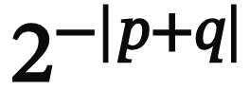
Coding theorem for stopping complexity (randomized)
Consider randomized stopping machines: finite program with access to infinite tape of random bits. Program p reads seed q from random tape and stops on string x.
For a string, consider
all programs plus seeds which read this string and halt
the shortest program plus seed which reads this string and halts
Weight program + seed according to sum of lengths:
Coding theorem for stopping complexity: is it true that 2) is at most by a constant factor less than 1) ?
Answer (GPT-5.6 Sol): No.

Slide 15
Plan
Solomonoff induction, AIXI agent, coding theorem
Stopping complexity, Golden handcuffs AIXI, stopping coding theorem
Proof of the coding theorem

Slide 16

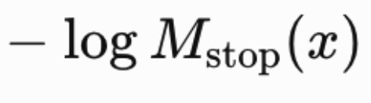
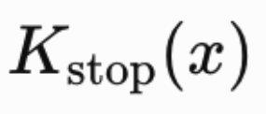
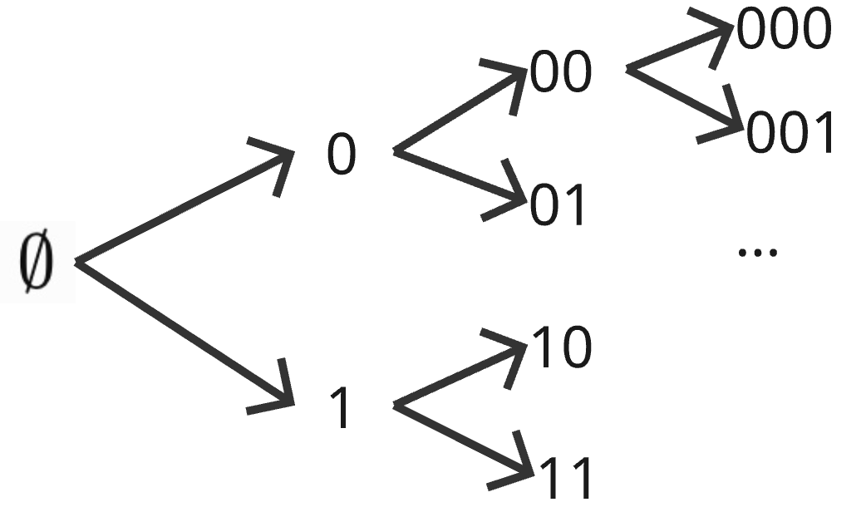

(failed) Coding theorem. There exist c such that for every x we have:
, where
corresponds to total mass of stopping at x
is length of shortest program plus seed stopping at x
Game.
Alice plays against Coding theorem. Declares mass (like ).
Constrain: sum along each path is at most 1
Bob defends Coding theorem. Answers declaration with discount (like )
Constrain: for any comparable declarations the answers must be not comparable

Slide 17
Thank you!

